Slide 1
COM521 Ethical Hacking and Penetration Testing
Penetration Testing

Slide 2
Penetration testing is one of the best ways to see if your security will hold.
It assesses the security model of the organisation
It puts testers in the role of attackers, looking for vulnerabilities in your networks, computers, applications, email, and even your users.

Slide 3
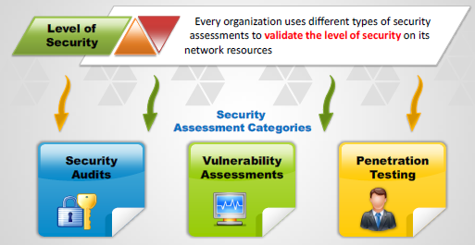
Security Assessments

Slide 4

Security Audit
Compliance
ISO27001 Information Security certification
ISO27017 Cloud Security
ISO27799 Information Security guide _ Health Information
Security Policies ensure the organisation has a set of standard security Policies
Legal And Regulatory – Different legal requirements
Data Protection act 2018 retained GDPR
Computer misuse act 1990 – 2 years in prison
Fraud act 2006 – 10 years in prison

Slide 5
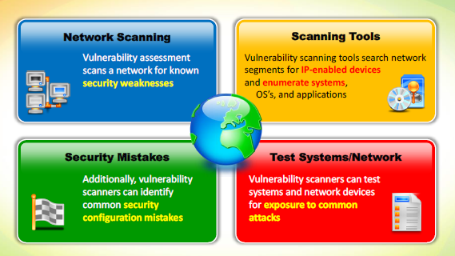
Vulnerability Assessment

Slide 6

Vulnerability Assessment Limitations
Only valid at one point in time
Updates changes etc will invalidate the assessment
Depends on the user rights of the pen tester etc
No indication if the vulnerabilities can be exploited
No Indication of amount of damage

Slide 7
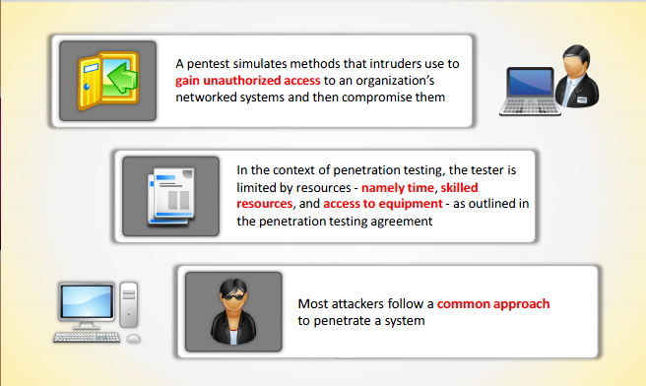
Penetration Testing

Slide 8

Goals of Penetration Test
Assess the Security Model
Reveal Potential Consequences
Identify Threats
Reduce longterm Costs
Regulation and best practices
Evaluate both devices and software and business applications
Evaluate a system which has changed
Demonstrates if vulnerabilities can be successfully exploited

Slide 9



Penetration Testing process
Establish Parameters : objectives and limitations
Use professionals
Use suitable tests
Proper Planning
Documentation
State Risks and findings

Slide 10
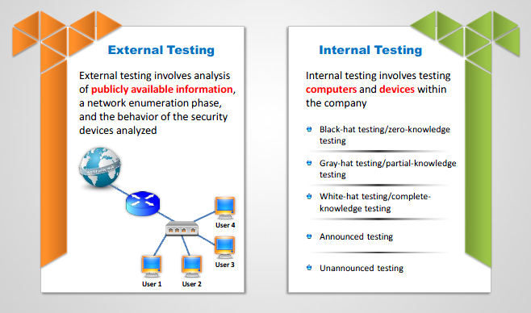
Types of Pen Test

Slide 11
White Box Testing
The testing team has complete access to the testing network and has been supplied with network diagrams, hardware, operating system and application details etc, prior to a test being carried out.
The amount of prior knowledge leads to a test targeting specific operating systems, applications and network devices that reside on the network rather than spending time enumerating what could possibly be on the network.
Not a blind test
Can speed up the process
More accurate results.

Slide 12
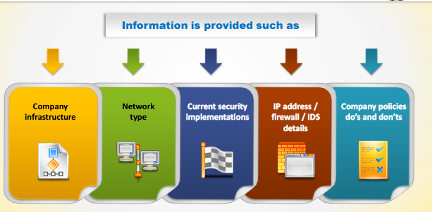
White Box Testing

Slide 13
Grey-Box Testing
The testing team would simulate an attack that could be carried out by a disgruntled, disaffected staff member.
The testing team would be supplied with appropriate user level privileges and a user account and access permitted to the internal network by relaxation of specific security policies present on the network i.e. port level security.

Slide 14
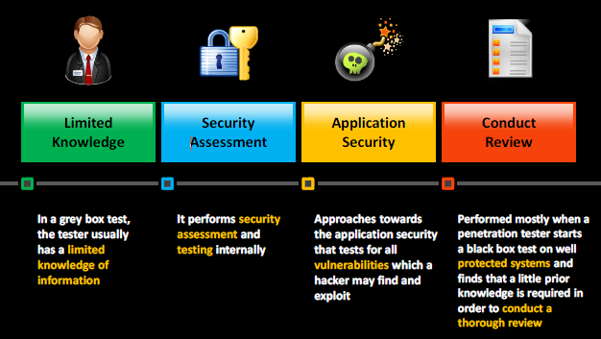
Grey Box Testing

Slide 15
Black-Box Testing
No prior knowledge of a company network is known.
An example of this is when an external web based test is to be carried out and only the details of a website URL or IP address is supplied to the testing team
This is the same as if the hacker breaks into the company website/ network.
This would equate to an external attack carried out by a malicious hacker.

Slide 16
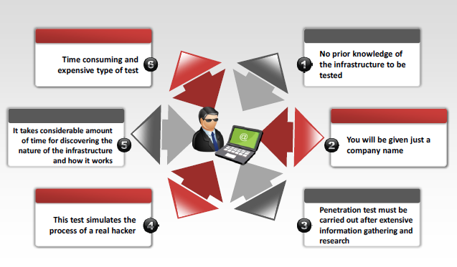
Black Box Testing

Slide 17
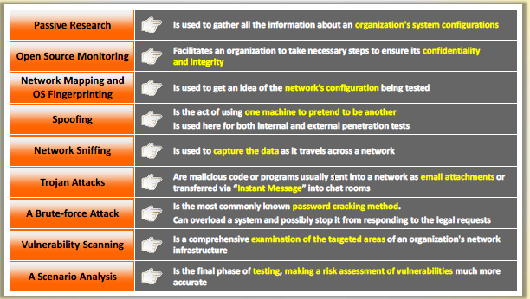
Techniques

Slide 18

Pre Attack Phase
Define Rules of engagement
Get Permission
Draft a legally binding contract created with knowledge and expertise.
Inform all critical stakeholders ?
Specify the Type, time and duration of the attack.
Sensitive data handling
Status meeting and reports

Slide 19

Attack Phase
Penetrate Perimeter
Enumerate Devices
Aquire Target
Discover Vulnerabilities
Exploit vulnerabilities
Buffer overflow
Inject payload
Phishing or Consequences
Social Engineering or Consequences
Escalate Privileges
Pivot or vertical movement
Cover tracks
Document all stages

Slide 20

Post Attack
Remove and Clean up
Restore network to pre attack phase
Reverse changes in software and users
Map Network
Document logs
Analyze results
Present in Report

Slide 21
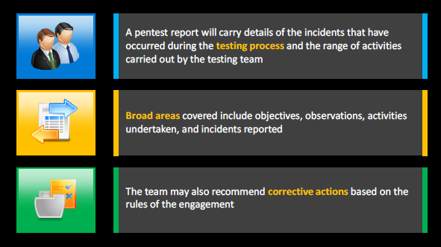
Pen Test Report

Slide 22
Introduction
An introduction to the Penetration testing and the target including any Aim objective , problem statement and or hypothesis. Describe the ethical hacking environment you have chosen to use as the target or container of the target, present a diagram of the hardware or virtual resources including the network topology and a table of network addresses, transport protocol flow diagram, application data flow and security protocol diagrams.
It will present a clear statement of your purpose – Why did you carry out the Pen test?
It will also indicate the scope of your testing the type of testing (Black box White box etc) and define any key terms which aid understanding in the introduction.

Slide 23
Introduction : Network Details
Number of Servers and workstations
Operating System Details
Any Major Software Applications
Hardware configuration and setup (could be unknown)

Slide 24
Introduction Test details
Scope of test
Constraints and limitations imposed on the tester i.e. Out of scope items, hardware, IP addresses.
Constraints, limitations or problems encountered by the tester during the actual test
Purpose of Test
Type of Test
Compliance Test
Vulnerability Assessment
Penetration Test
Test Type
White-Box
Black-Box
Grey-Box

Slide 25
Intelligence Gathering
Describe and document information gleaned about the target with passive methods of research, footprinting and reconnaissance.
And / or Document results of active intelligence gathering eg target scanning.

Slide 26
Vulnerability Analysis and or Penetration Testing
Discover and document vulnerabilities of the specific target.
Automated vulnerability scan
Manual audit and Vulnerability assessment
Exploitation
The attack narrative, describe what, how and why you attacked the specific target.
Describe any malware and or hacking tools used.
Include notes images screenshots and diagrams.

Slide 27
Post Exploitation
One or some of the following:
Compromising systems,
Finding files or data, exfiltration of data, hiding data,
Escalating privileges, obtaining passwords.
Planting malware, scripting, rooting, patching, network configuration and access control modification.

Slide 28
Conclusions
Draw conclusions on the success of the attack analyse malware & identify its mechanisms for exploitation and concealment.
OS Security issues discovered with appropriate criticality level specified
Exploited
Causes
Unable to exploit - problem area
Causes
Hardware failing
Software failing
Human error
Application Security issues discovered with appropriate criticality level specified
Exploited
Unable to exploit - problem area
General Security issues discovered with appropriate criticality level specified
Exploited
Unable to exploit - problem area

Slide 29
Recommendations
Recommend methods for :
Vulnerability repair
Mitigation
Malware detection methods.
Improving Security Monitoring
Recommend security roles
A Computer Security Incident Response Team (CSIRT)
Continuity and Disaster Recovery Plans

Slide 30
Summary
Pen Testing assesses the security model of the organisation
A Pen Test simulates methods intruders use to gain unauthorised access
Security Assessment categories are security audits, vulnerability assessments and penetration testing
Test types can be White box, Grey box or Black Box
Depends on Clients operating environment threat perception, security policies, compliance requirement, return on investment and Budget
Draft a contract with legal expertise
Phases of the test are Pre Attack Attack phase and post attack
The report will document the attack and may provide recommendations.

